Slide 1


LJ University
Property pursuit
Created By:
Darji Sahil - 24002170120002
Makwana Vrajesh - 24002170120008
Padmani Arpit - 24002170120010
Shah Nakul - 24002170120023
Suthar Krutik - 24002170120025

Slide 2
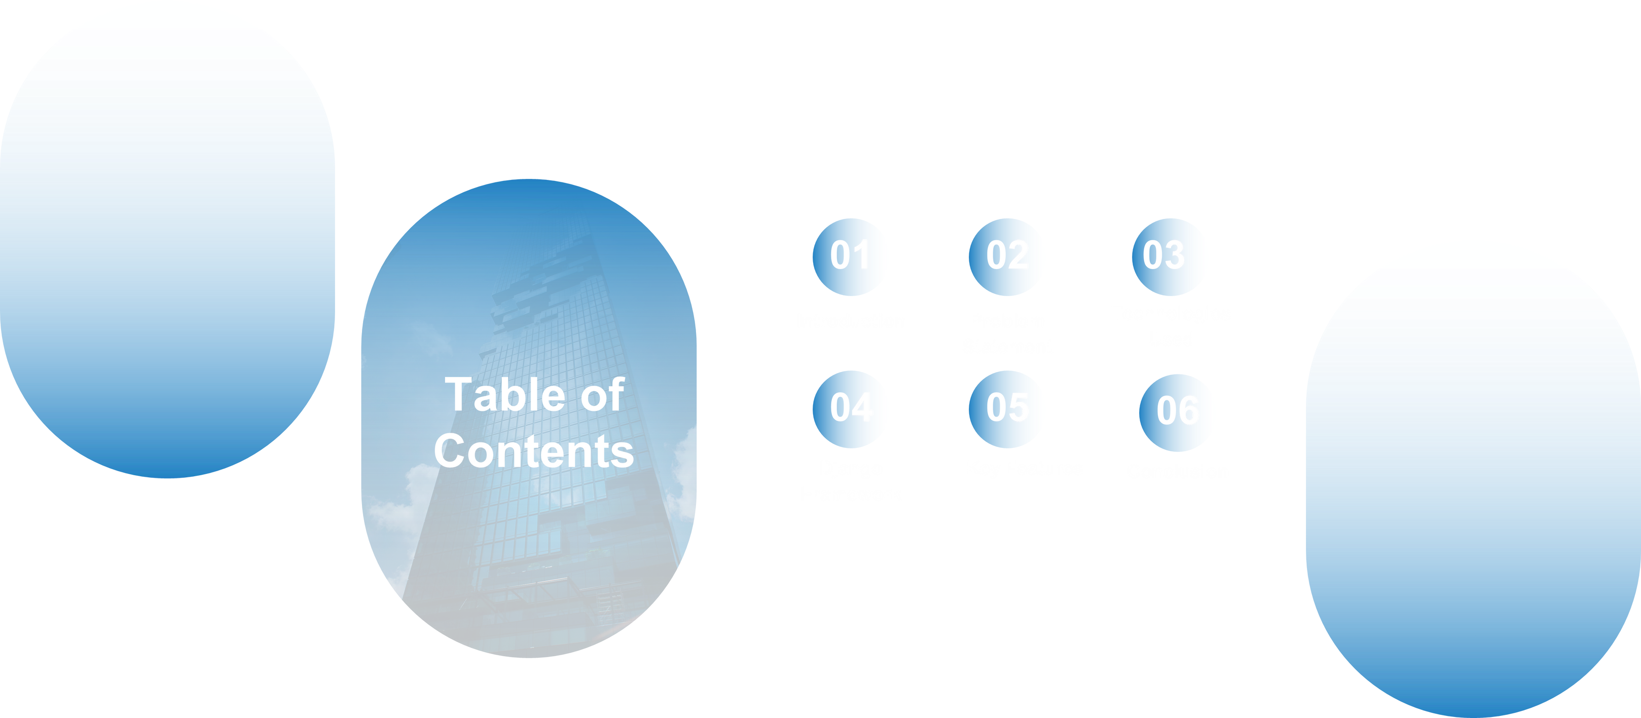

Slide 3





01
INTRODUCTION
Property Pursuit is a web platform for buying, selling, and renting real estate.
It connects property seekers and property owners in a simple, intuitive way.

Slide 4

PROBLEM
STATEMENT
02
01
Traditional property search is time-consuming and inefficient.
02
Lack of verified listings and up-to-date property data.
03
Hard to filter properties based on preferences.
04
No unified platform to connect buyers, sellers, and renters effectively.

Slide 5
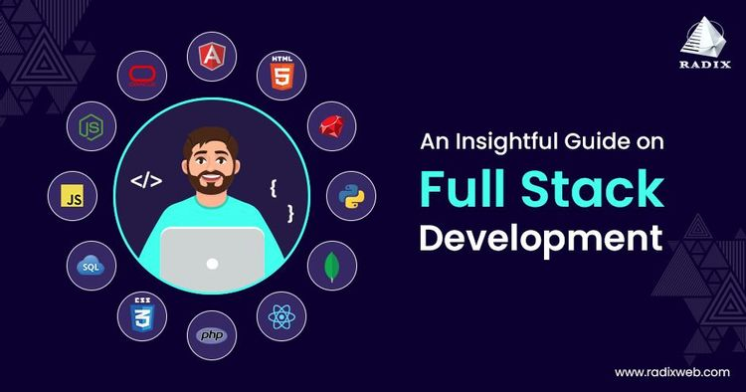
03
TECHNOLOGIES USED
Frontend:
HTML, CSS, JavaScript, Bootstrap
Backend:
Python, Django
Database:
MYSQL

Slide 6


Django is a high-level Python web framework.
04
BENEFITS:
Fast development
Secure and scalable
Built-in admin panel
USED FOR:
User authentication
Database models
Property listings and search
Admin and dashboard handling
DJANGO FRAMEWORK

Slide 7

KEY FEATURES
05
•User Registration and Login
•Add/View/Filter Property Listings
•Property Search by Location, Price, Type
•Contact Owner Feature
•Admin Panel to Manage Listings
•Responsive Design for Mobile and Desktop

Slide 8

06
CONCLUSION
Property Pursuit bridges the gap between real estate seekers and providers.
Helps users make informed decisions with less effort.
Built using Django for efficiency and speed.
Scope for future improvements like payment gateway, AI recommendations, and map integration.

Slide 9

THANK YOU

